Slide 1

Visión por Computador
Domingo Mery
Departamento de Ciencia de la Computación
Escuela de Ingeniería
Universidad Católica de Chile
Definitions
[ PART I ]

Slide 2
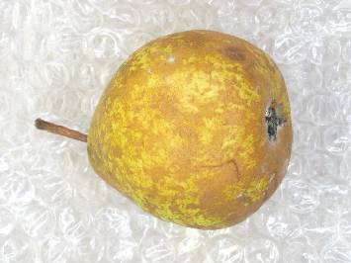

Image Processing:
The use of computer algorithms that take an image as input and return an image as output.
[ INPUT ] [ OUTPUT ]

Slide 3
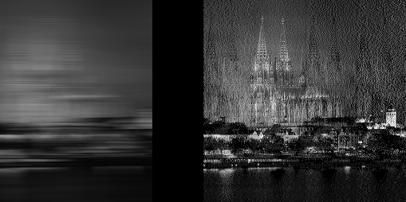
Image Processing:
The use of computer algorithms that take an image as input and return an image as output.
[ INPUT ]

Slide 4
Image Processing:
The use of computer algorithms that take an image as input and return an image as output.
[ INPUT ] [ OUTPUT ]

Slide 5
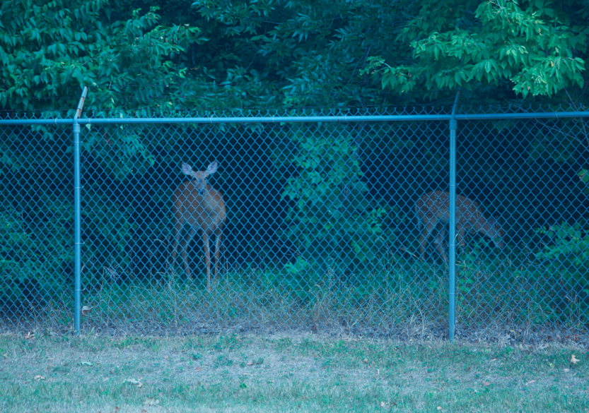
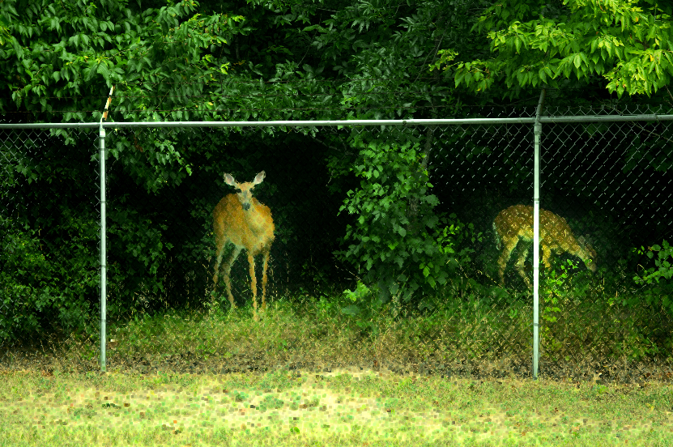
Image Processing:
The use of computer algorithms that take an image as input and return an image as output.
[ INPUT ] [ OUTPUT ]

Slide 8
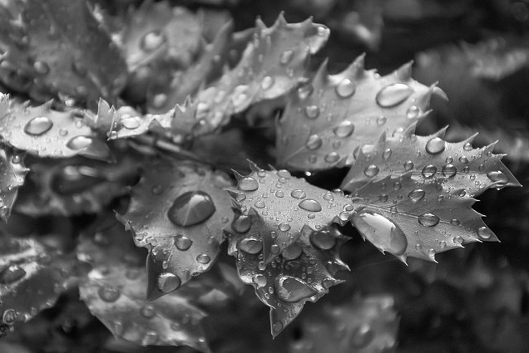
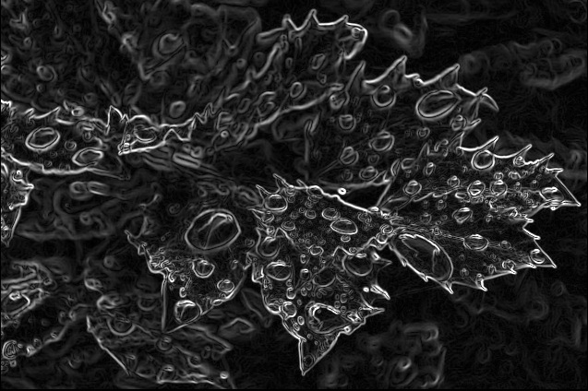
Image Processing:
The use of computer algorithms that take an image as input and return an image as output.
[ INPUT ] [ OUTPUT ]

Slide 10
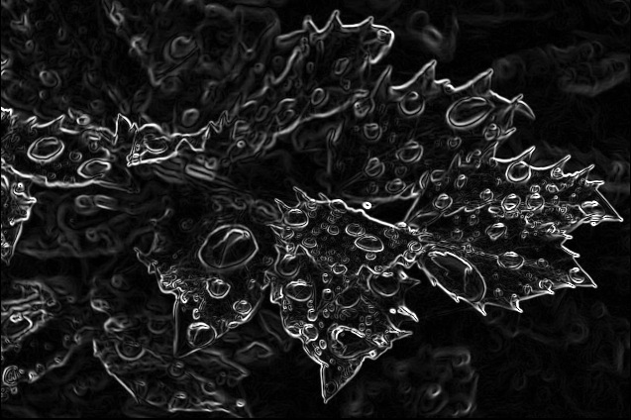

Slide 11
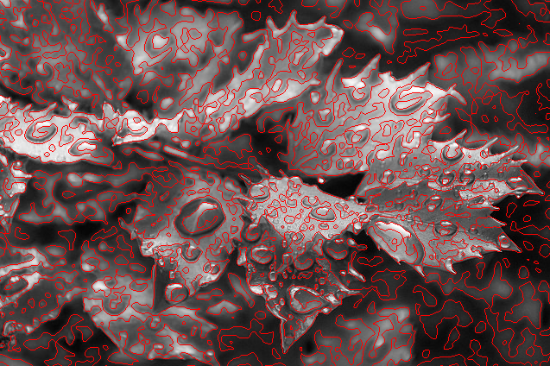

Slide 12
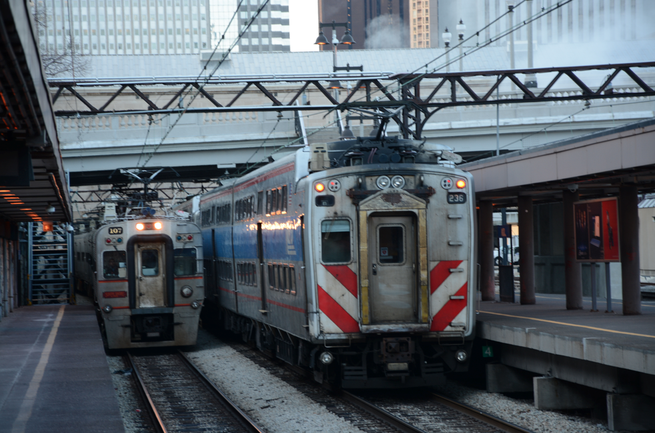
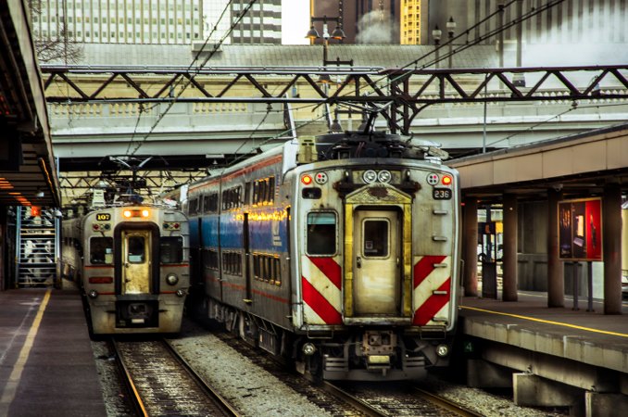
Image Processing:
The use of computer algorithms that take an image as input and return an image as output.
[ INPUT ] [ OUTPUT ]

Slide 15
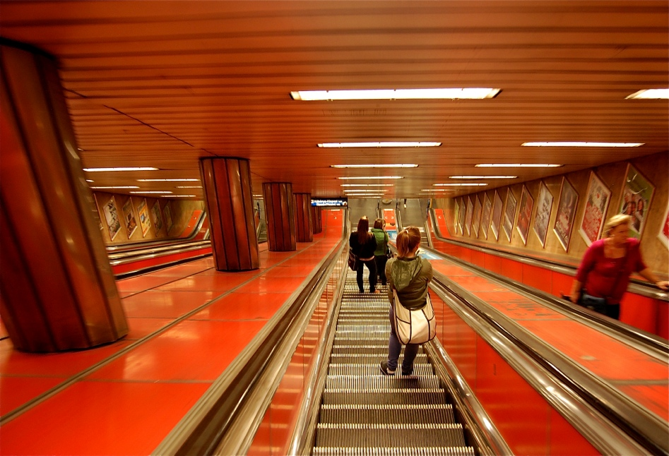
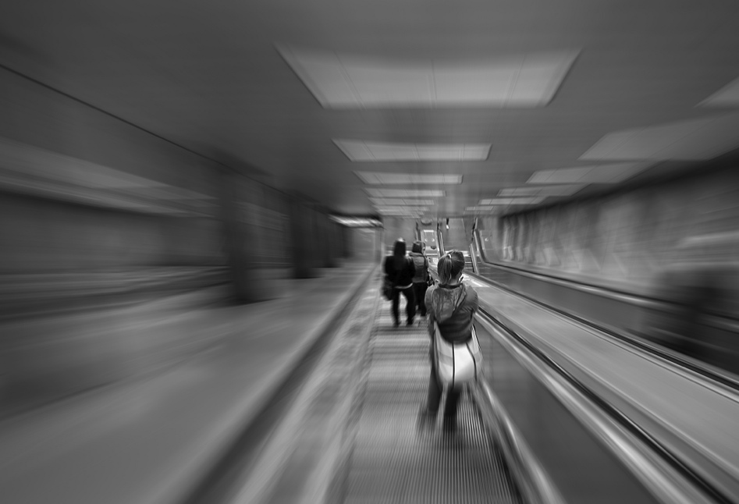
Image Processing:
The use of computer algorithms that take an image as input and return an image as output.
[ INPUT ] [ OUTPUT ]

Slide 16
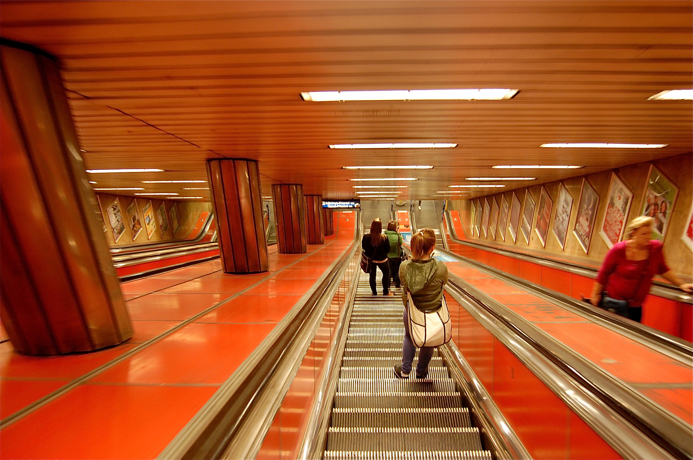

Slide 17
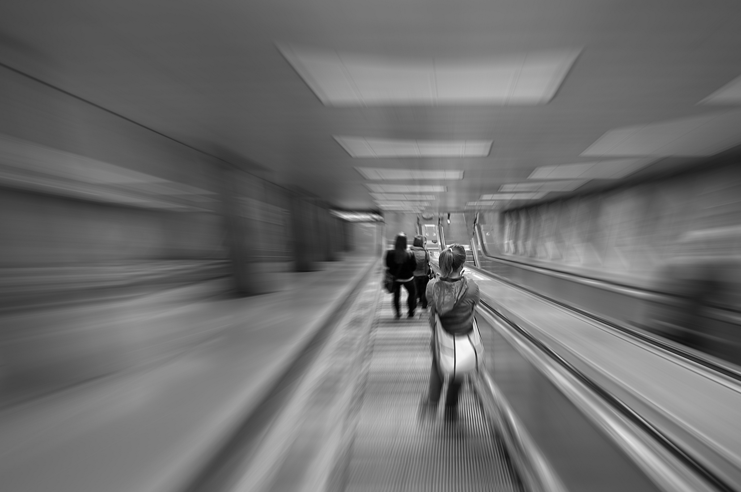

Slide 18
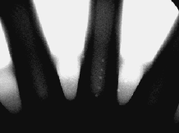
Image Analysis:
The use of computer algorithms that take an image as input and return a measurement, an interpretation or a decision.
The wheel has 7 defects

Slide 19
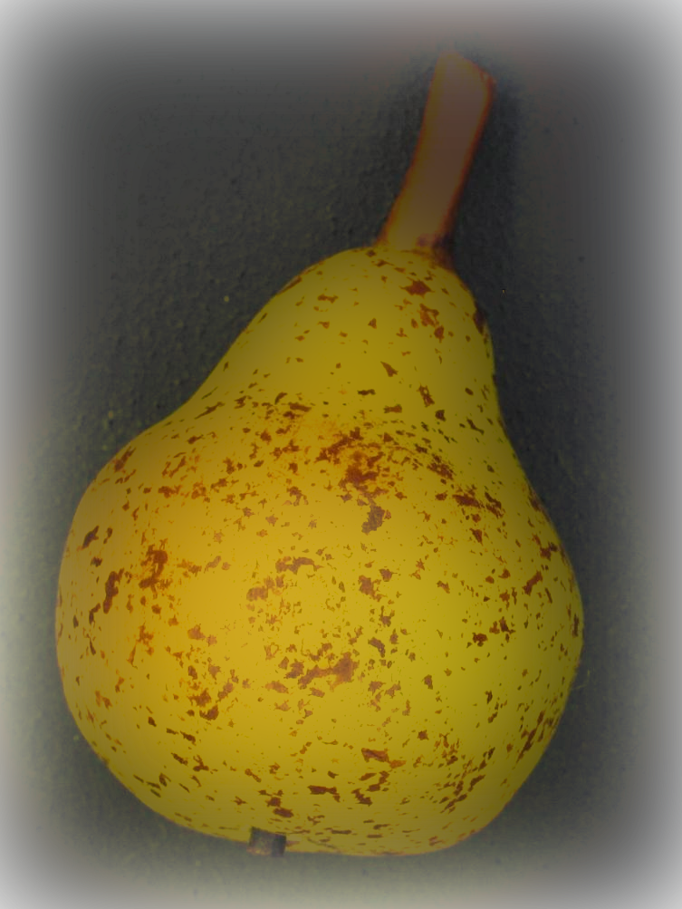


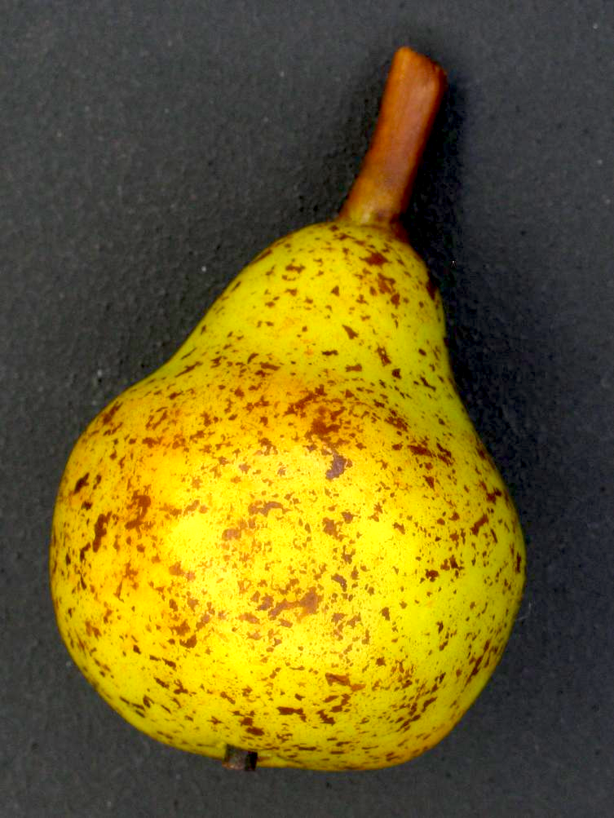
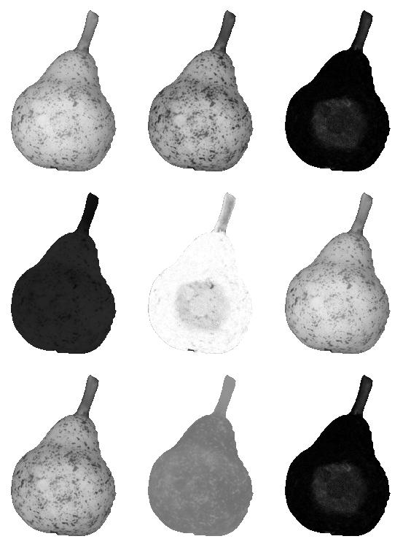
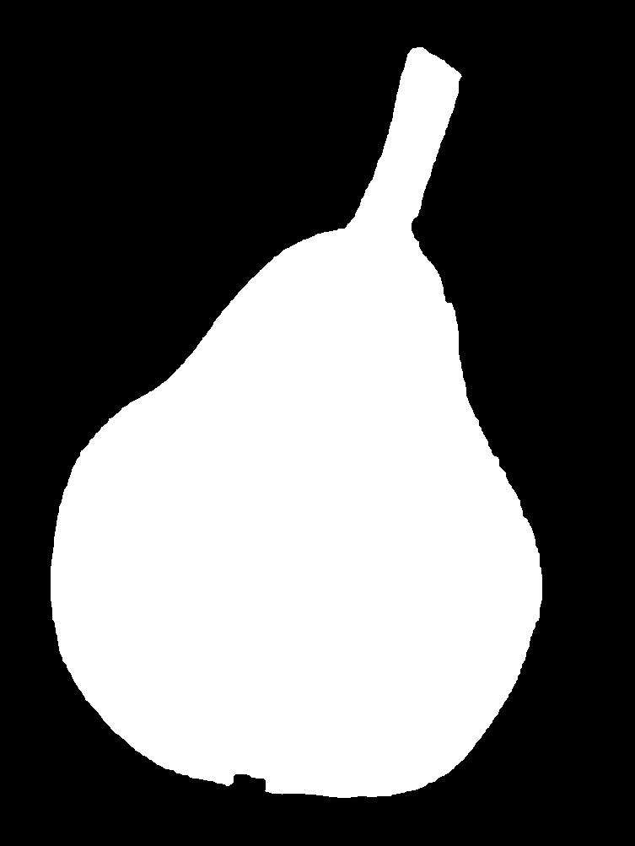
1. Image Acqusition
2. Preprocessing
3. Segmentation
R G B
color
geometry
4. Feature
Extraction
H S V
Feature | Value
Intensity (Yellow) | 0.9875
# spots | 542
: | :
5. Clasification
L* a* b*
“premium”

Slide 20
Pattern Recognition:
It is the science of making inferences based on data. Usually, it measures an object in order to assign it to a class.
HEARTBEAT = 165 bpm
AGE = 45 year
ALARM = ON
SEX = F

Slide 21
1. Image Acqusition
2. Preprocessing
3. Segmentation
R G B
color
geometry
4. Feature
Extraction
4. Feature
Extraction
H S V
Feature | Value
Intensity (Yellow) | 0.9875
# spots | 542
: | :
Pattern Recognition:
5. Clasification
L* a* b*
“premium”

Slide 22
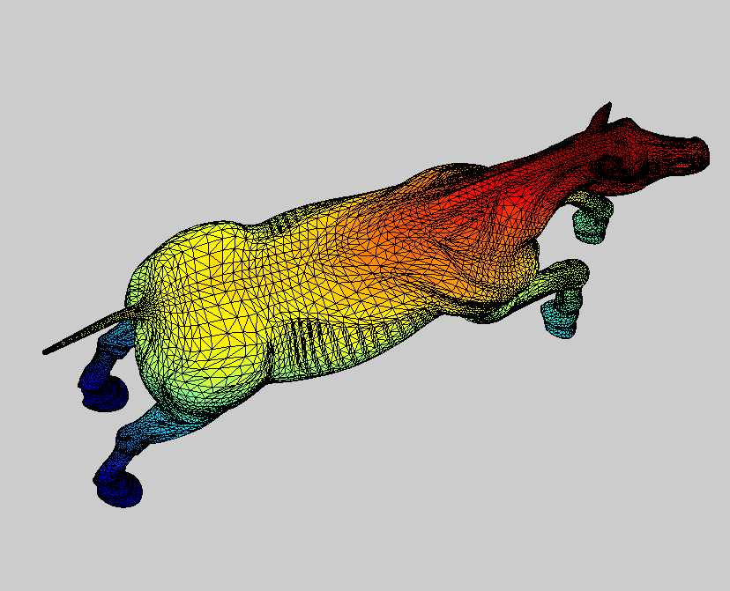
Computer Graphics:
The use of computer algorithms to generate images from models (3D objects, texture, color, illumination, etc.).
[ CV01_ComputerGraphics.m ]
© Iván Sipirán
Notes:
Generation of 3D meshes > blackboard

Slide 23
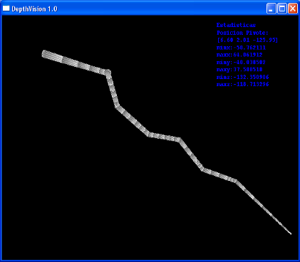
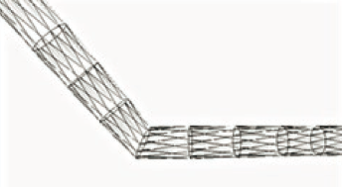
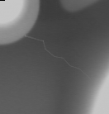
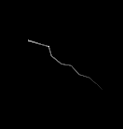
Computer Graphics:
The use of computer algorithms to generate images from models (3D objects, texture, color, illumination, etc.).
Depth map
Simulation
3D mesh
Mery, D.; Hahn, D.; Hitschfeld N. (2005): Simulation of Defects in Aluminium Castings Using CAD Models of Flaws and Real X-ray Images. Insight, 47(10):618-624. [ PDF ]

Slide 24

Computer Graphics:
The use of computer algorithms to generate images from models (3D objects, texture, color, illumination, etc.).

Slide 25
Computer Vision:
Computer vision is the science of endowing computers the ability to see. [ Faugeras ]
Notes:
What do you think? Can a computer see?
We will leave the definition as it is, and strive to endow computer vision systems with as many capabilities as we can rather than dwelling on whether we have built a system that can truly see.

Slide 26

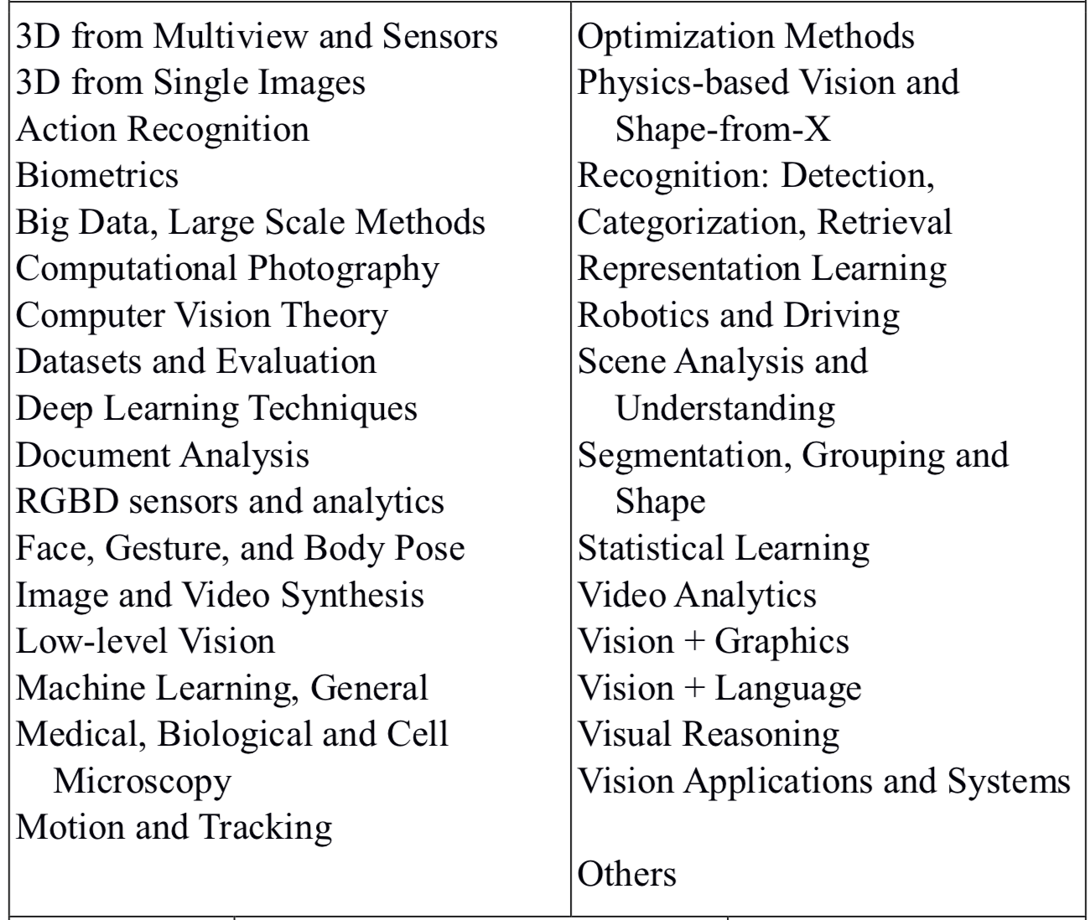
CALL FOR PAPERS – CVPR 2019

Slide 27

CALL FOR PAPERS
WACV2022
Topics of interest include, but are not limited to:
3D computer vision
Action and behavior recognition
Adversarial learning, adversarial attack and defense methods
Biometrics, face, gesture, body pose
Computational photography, image and video synthesis
Datasets and evaluation
Efficient training and inference methods for networks
Explainable AI, fairness, accountability, privacy, transparency and ethics in vision
Image retrieval
Low-level and physics-based vision
Machine learning architectures and formulations
Medical, biological and cell microscopy
Motion and tracking
Neural generative models, auto encoders, GANs
Optimization and learning methods
Recognition (object detection, categorization)
Representation learning, deep learning
Scene analysis and understanding
Segmentation, grouping and shape
Transfer, low-shot, semi- and un- supervised learning
Video analysis and understanding
Vision + language, vision + other modalities
Vision applications and systems, vision for robotics and autonomous vehicles
Visual reasoning and logical representation

Slide 28
Computer Vision:
Computer vision is the science of endowing computers the ability to see. [ Faugeras ]
Computer vision is a field that includes methods for acquiring, processing, analyzing, and understanding images and, in general, high-dimensional data from the real world in order to produce numerical or symbolic information, e.g., in the forms of decisions. [ wikipedia ]
Notes:
What do you think? Can a computer see?
We will leave the definition as it is, and strive to endow computer vision systems with as many capabilities as we can rather than dwelling on whether we have built a system that can truly see.

Slide 29
Computer Vision System:
Object
Image
Acquisition
Image
Processing
Image
Analysis
Photography
X rays
Thermography
Restoration
Filtering
Segmentation
Feature extraction
Feature selection
Machine Learning
Classification
Measurements
Interpretation

Slide 30
Computer Vision System:
Object
Image
Acquisition
Image
Processing
Image
Analysis
Multi-view
Analysis
Decision
Photography
X rays
Thermography
Restoration
Filtering
Segmentation
Feature extraction
Feature selection
Machine Learning
Classification
Measurements
Interpretation
Matching
Tracking
3D reconstruction
Calibration
knowledge base
(optional)

